Slide 1

SOLDERING STATION

Slide 2
TABLE OF CONTENTS
PCB SCHEMATIC DESIGN
3D CASE
THE PRINT

Slide 3
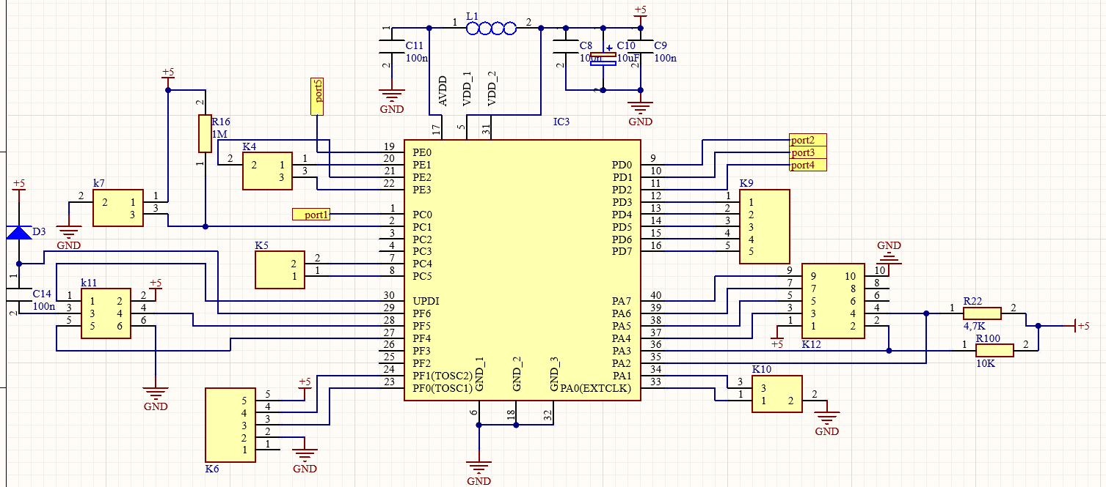
PCB SCHEMATIC DESIGN

Slide 4
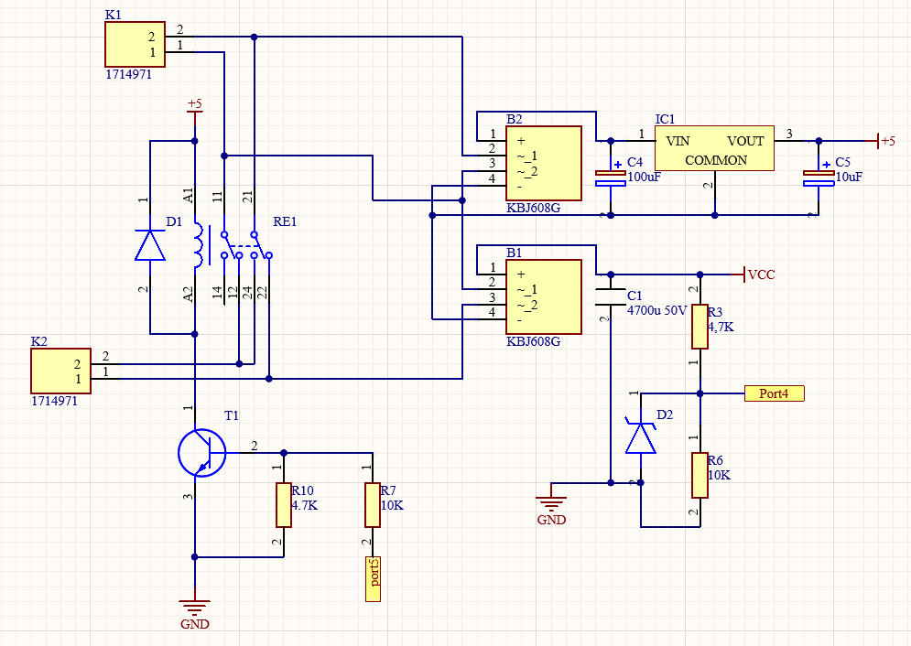
PCB SCHEMATIC DESIGN

Slide 5
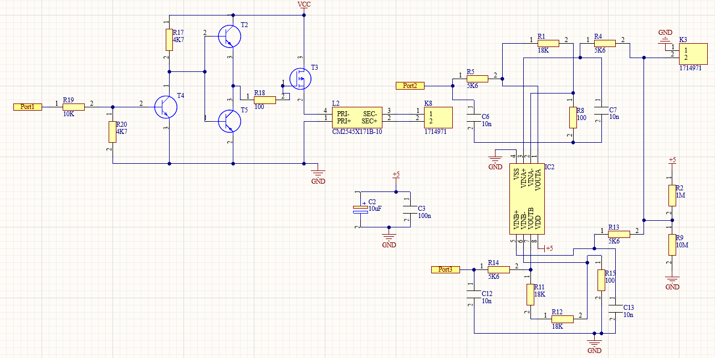
PCB SCHEMATIC DESIGN

Slide 6
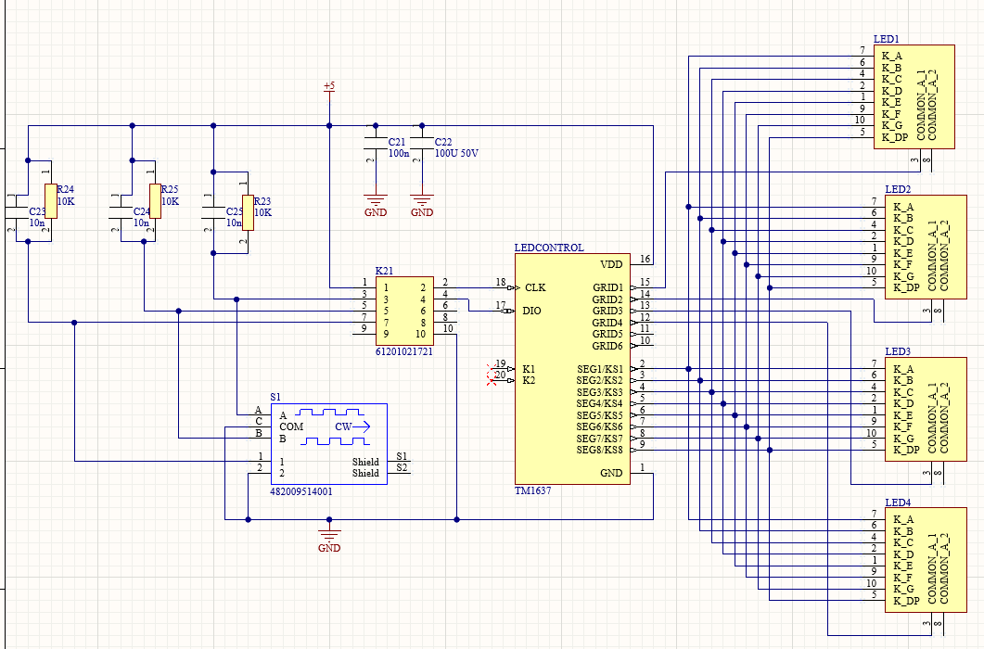
PCB SCHEMATIC DESIGN

Slide 7
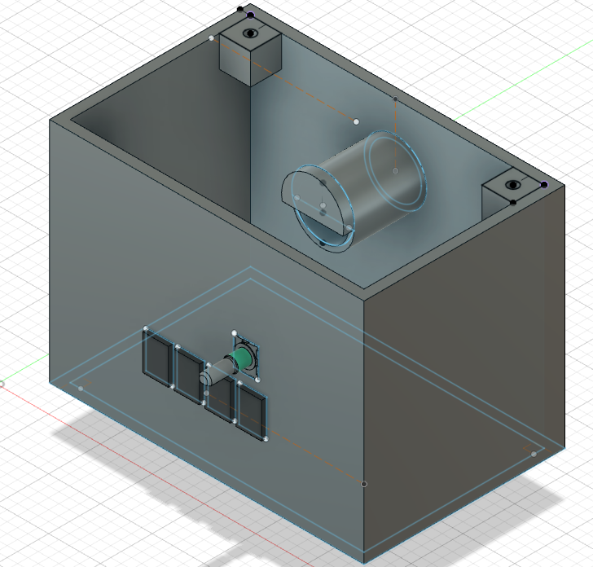
3D CASE

Slide 8
THE END

